Slide 1
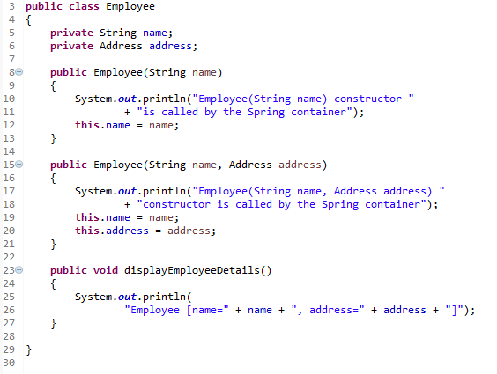
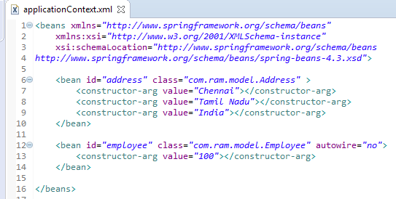
No auto-wiring mode
In case of no auto-wiring mode, spring container doesn't inject the dependency by auto-wiring.

